Slide 1
Google Travel review Rating
Shiyun Zhao, Weifeng Guo, William Peng

Slide 2
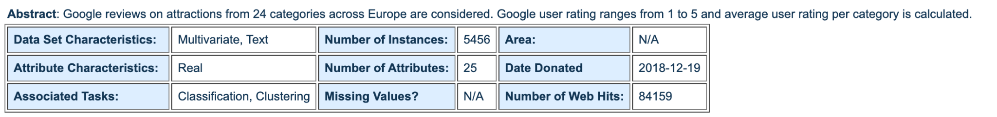
Backgrounds
Data
Goal 1
Goal 2
Popular travel points
Personalized advertisement
Online rating
By grouping raters using clustering, we can know group of people’s preferences, and promote personalized Ads
Focus on travel field
Can find out which kind of place have highest popularity

Slide 3
02
Data
Section
Data Description, Data cleaning, Feature Statistic and Description, and Feature Engineering

Slide 4
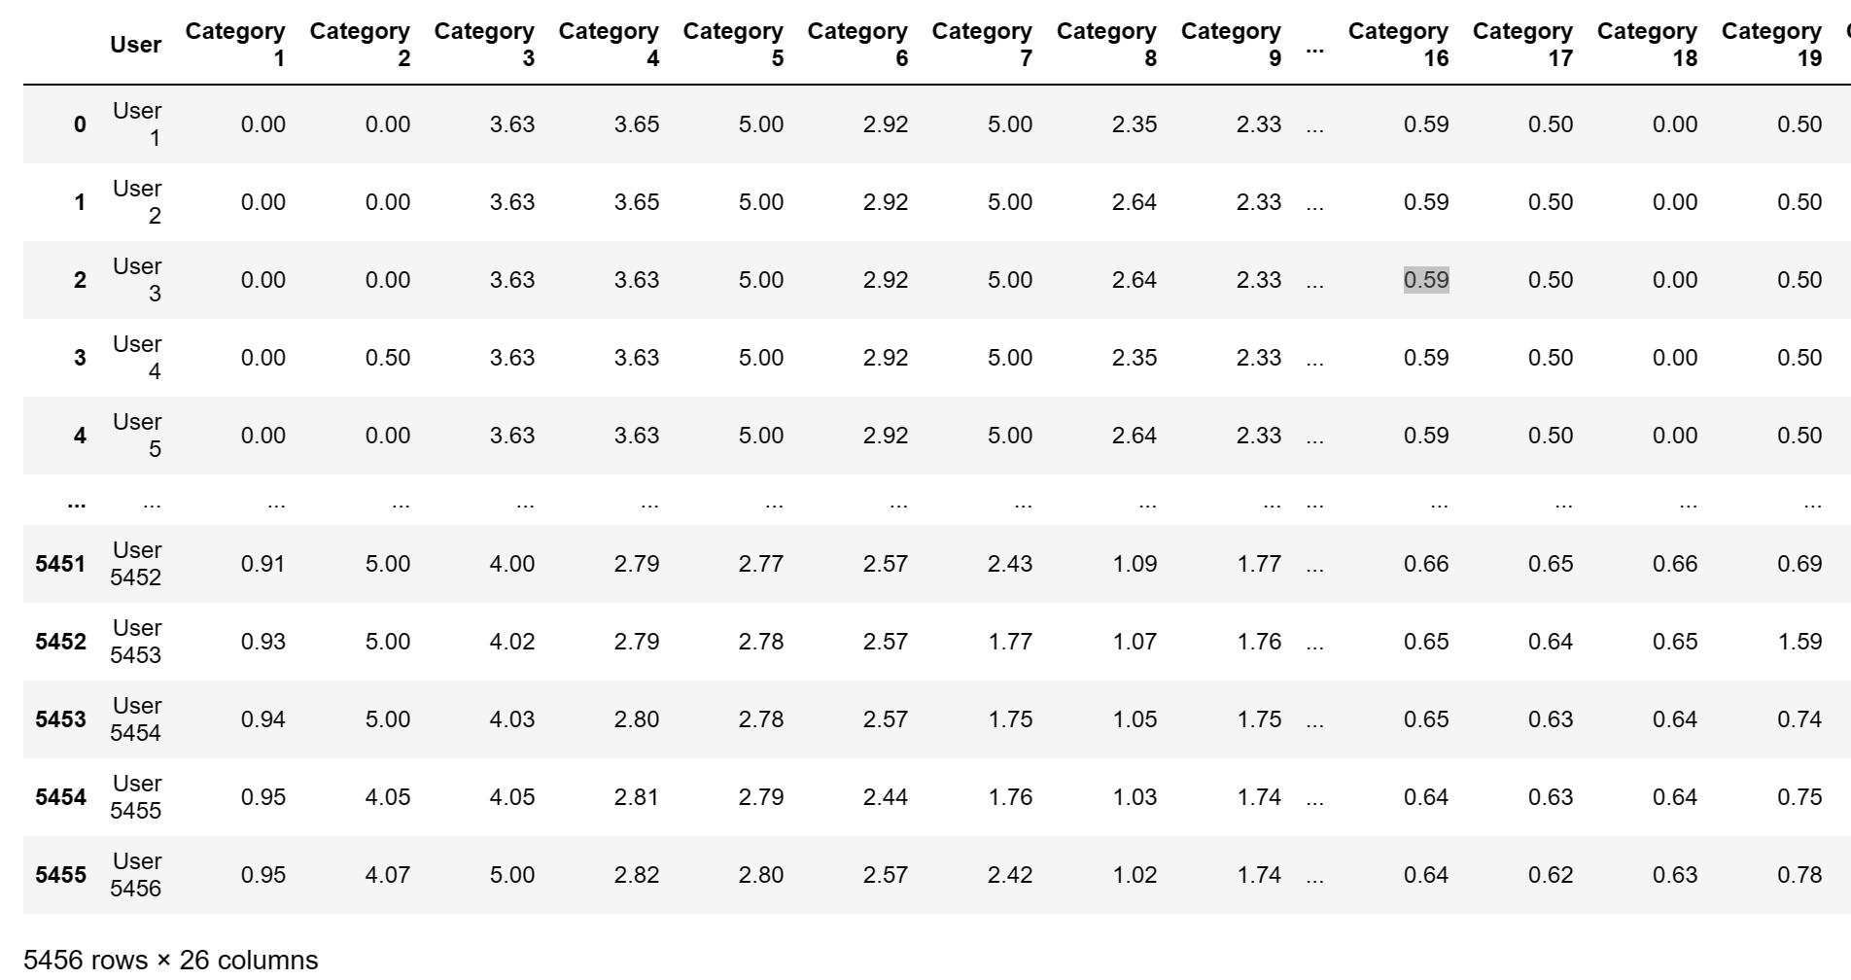
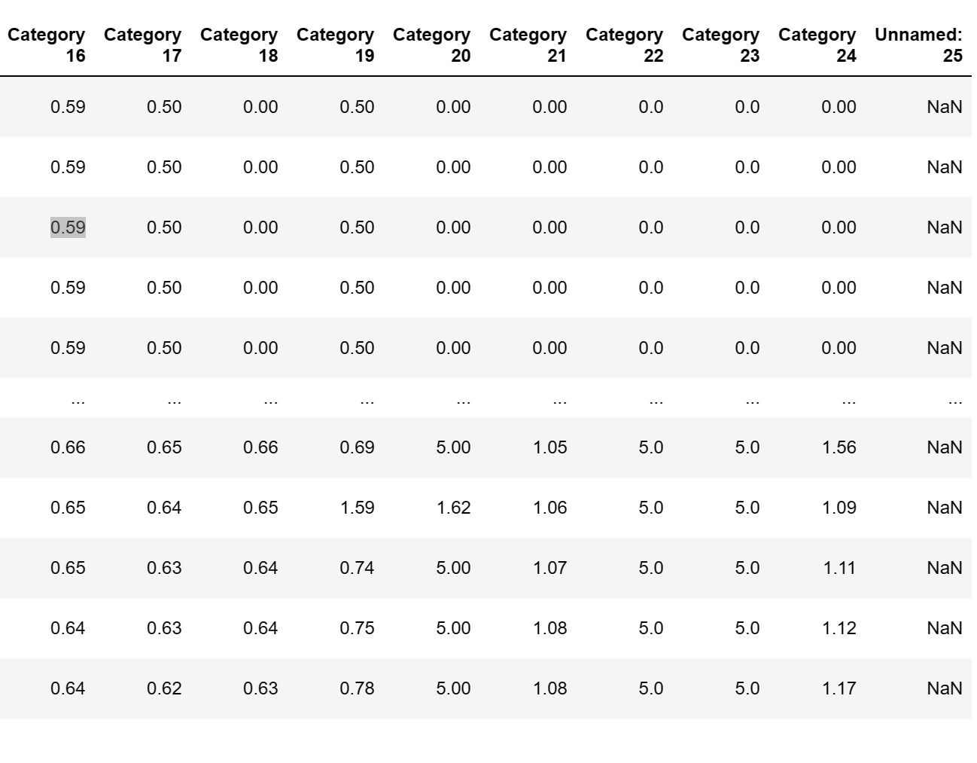
Original Dataset

Slide 5
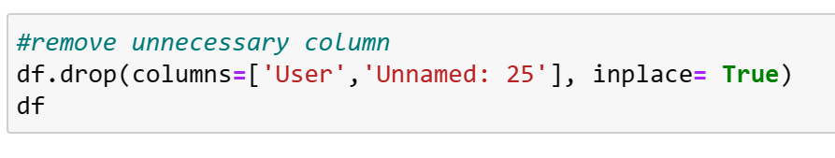
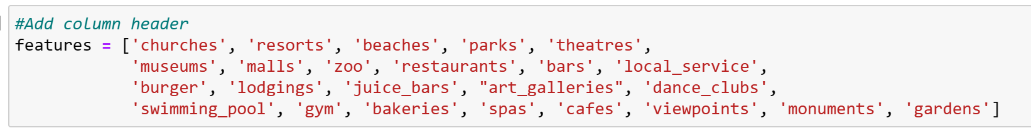
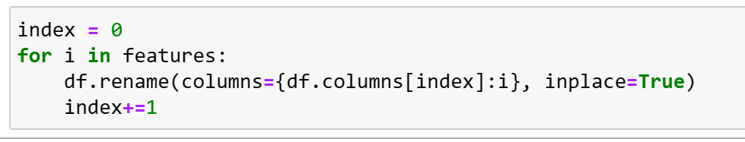
Remove Useless Column
Rename Column

Slide 6
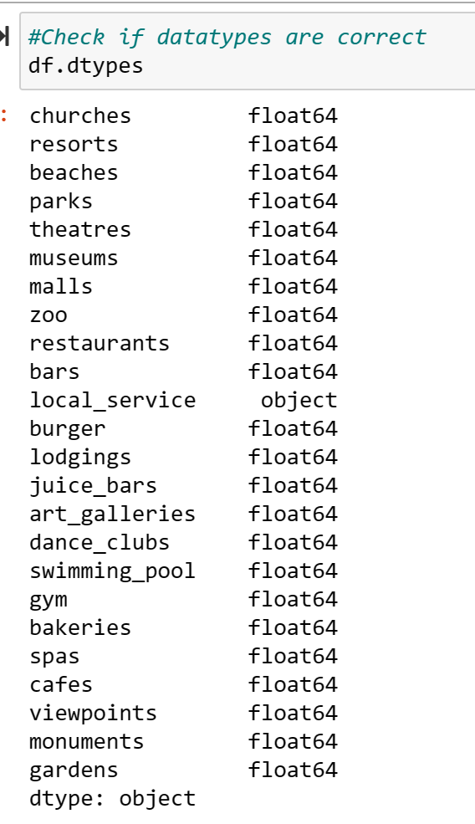
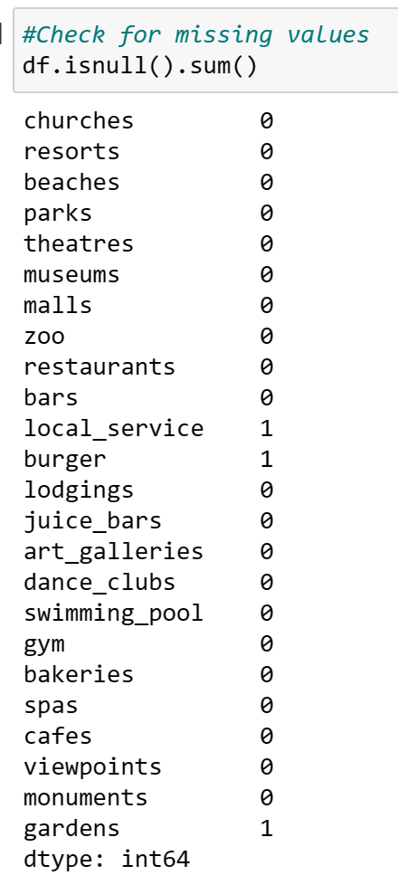
Check Data Types and Missing Values

Slide 7
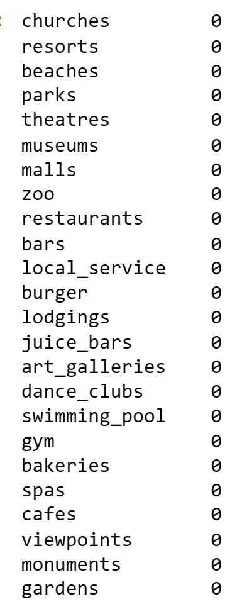
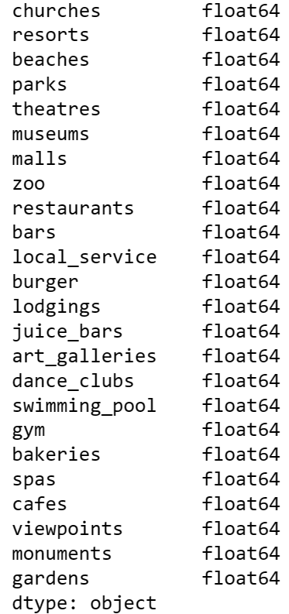
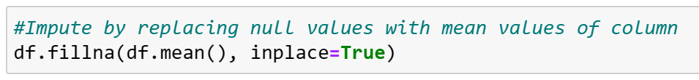
Change the data type
Fill the Null cell
Change the datatype of column ‘local_service’ to float
Impute by replacing the null values with the mean values of that column

Slide 8
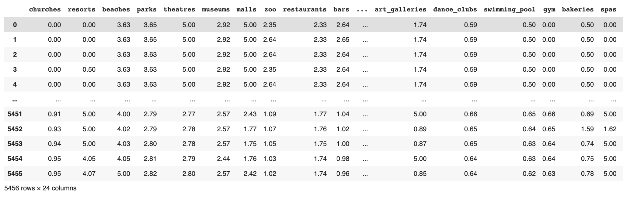
Cleaned Data

Slide 9
Data Description
Collection Data
Rating Scale
cross-sectional data created at 2018-12-19
All the ratings are scaled from 0 to 5
Column Information
Row Information
24 column represent 24 different category of rating
5456 rows represent total of 5456 users make rating

Slide 10
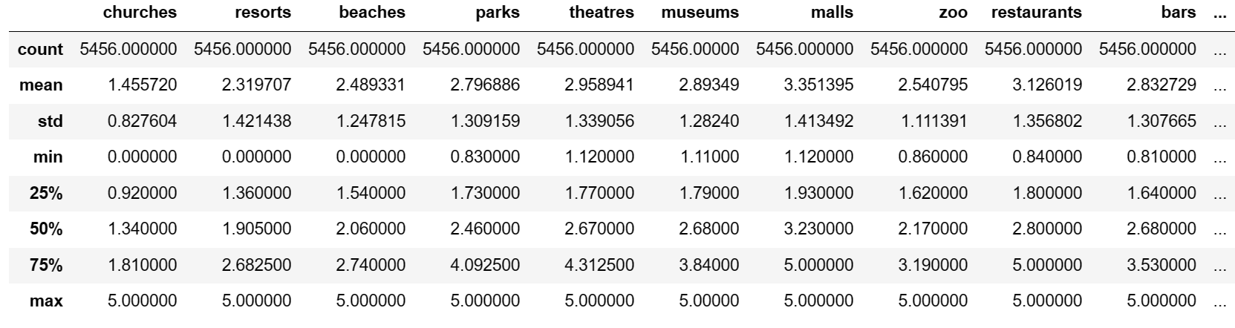
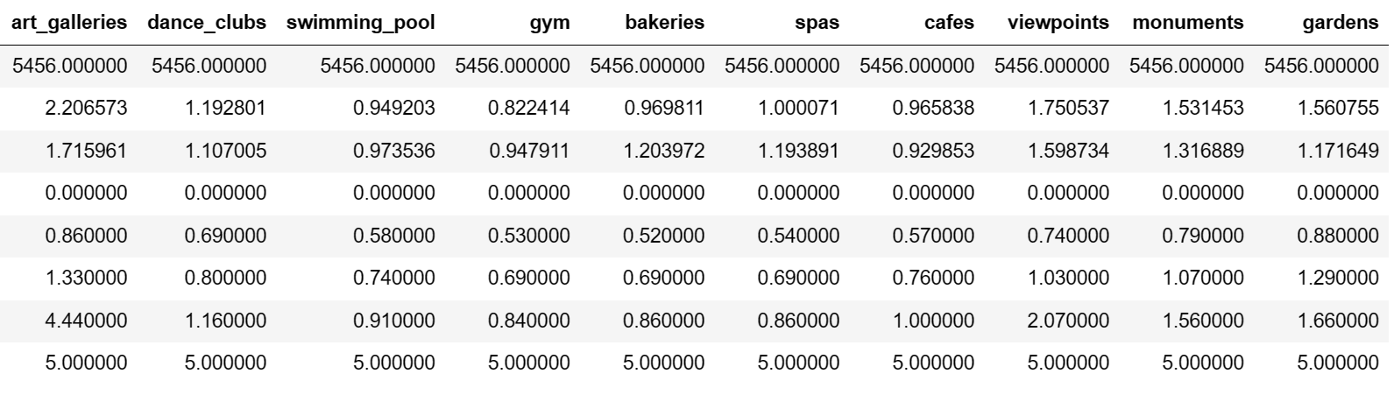
Descriptive Statistics

Slide 11
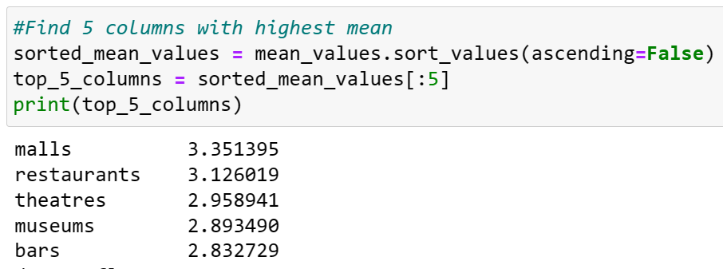
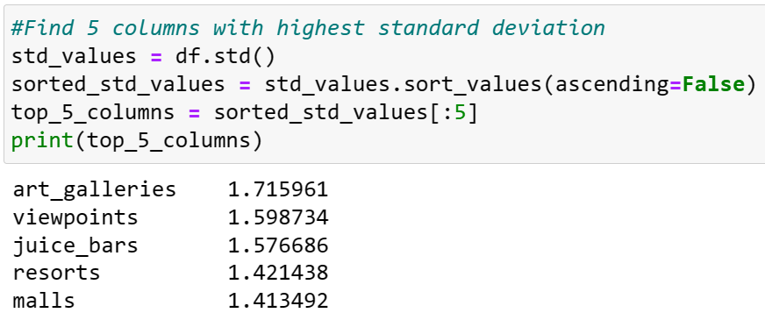
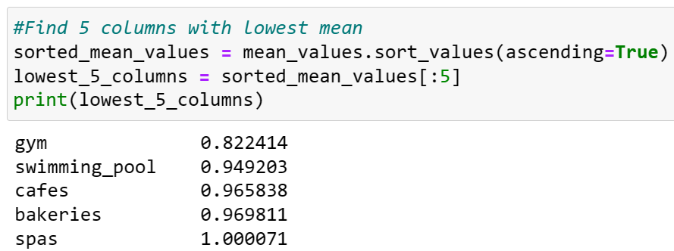
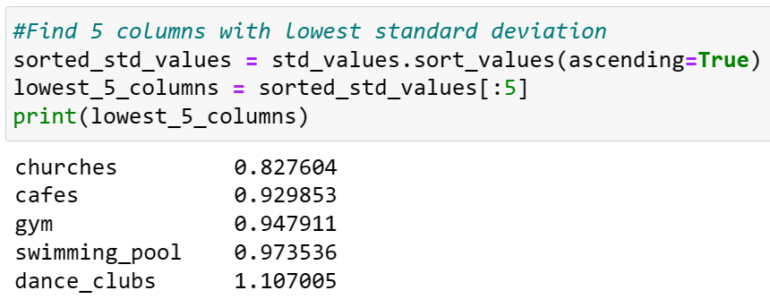
Average & Standard Deviation
Highest Mean
Highest S.D
Lowest Mean
Lowest S.D
Notes:
We c

Slide 12
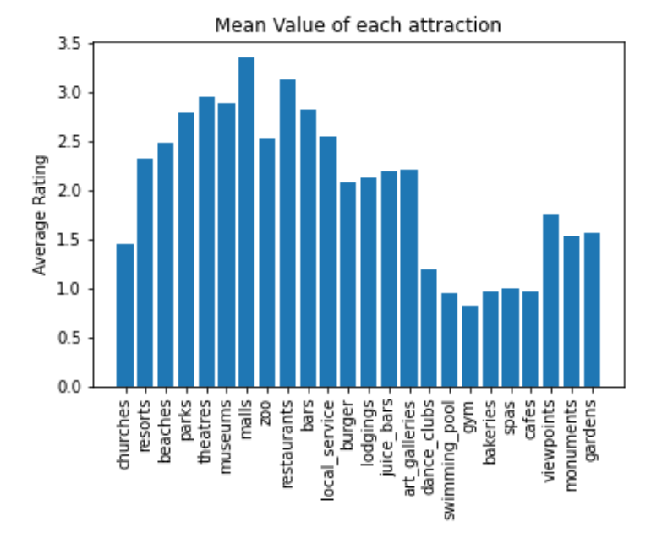
Average Comparism
Malls have the highest mean rating value
Gym have the smallest mean rating value

Slide 13
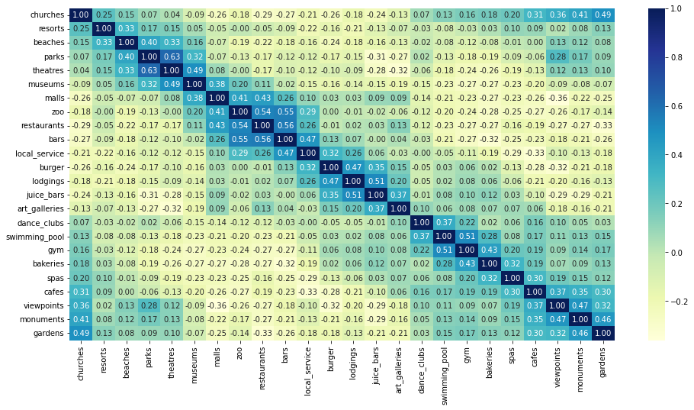
Correlation of Between Each Column

Slide 14
Visualization with Principal Component Analysis

Slide 15
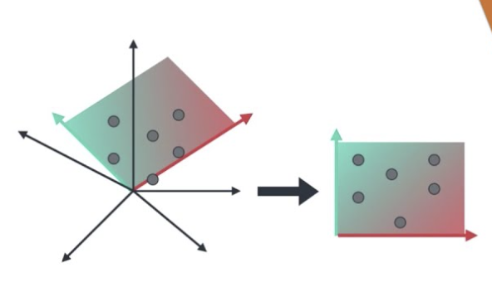
What is PCA?
Transforms high-dimensional data into a lower-dimensional representation
Data is broken down into ‘ principal components’, a new sets of variables.
Notes:
Principal Component Analysis (PCA) is a dimensionality reduction technique used to transform high-dimensional data into a lower-dimensional representation. It aims to capture the most important patterns, which is referred to as variations, in the data by creating a new set of variables called principal components. Why are we using PCA? Since we have a large amount of features, it would be difficult to visualize the data as human eyes can only see up to 3 dimensions, so we used PCA to reduce the data into 2 or 3 components

Slide 16
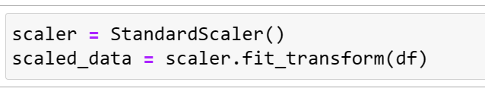
Standard Scaler
Stardardizing Data

Slide 17
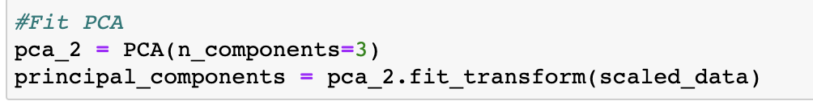
Fitting scaled data to PCA model

Slide 18
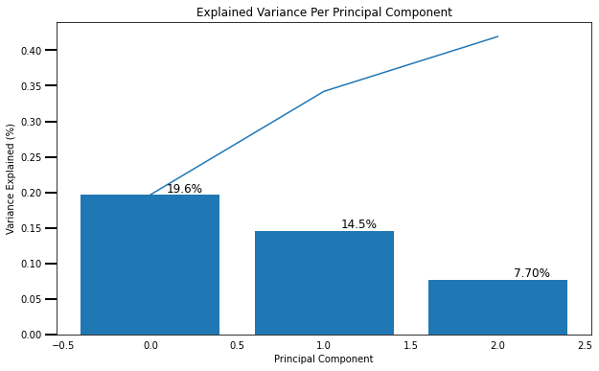
Scree Plot

Slide 19
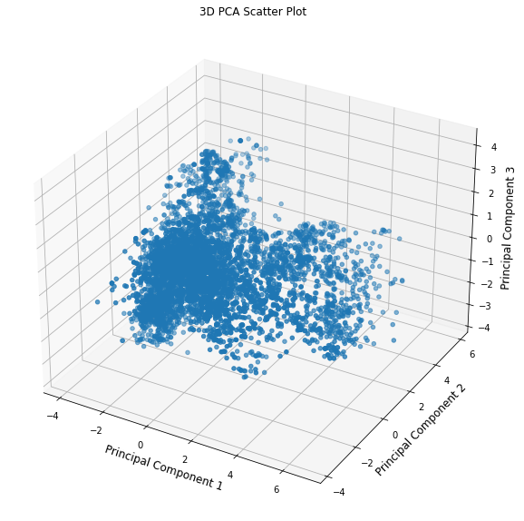

Slide 20
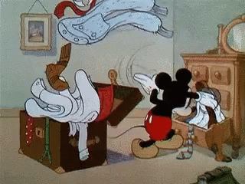
Finding K

Slide 21
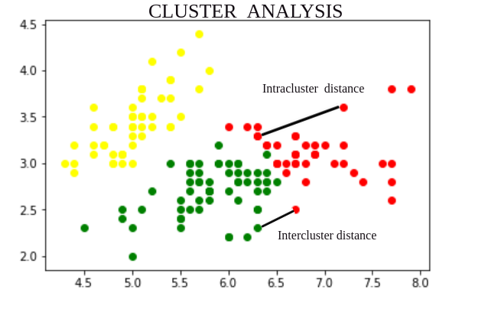

Slide 22
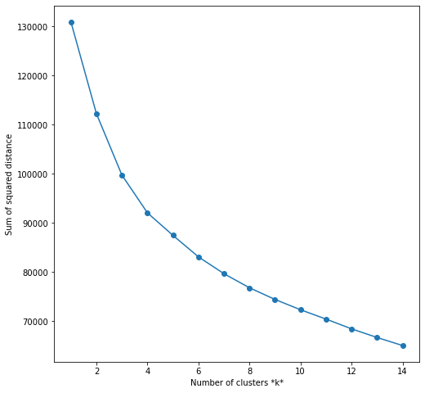
Elbow Method
Sum of Squared distance is also know as inertia and within-cluster sum of squares (WCSS)
Lower values of WCSS indicate higher intra-cluster similarity

Slide 23
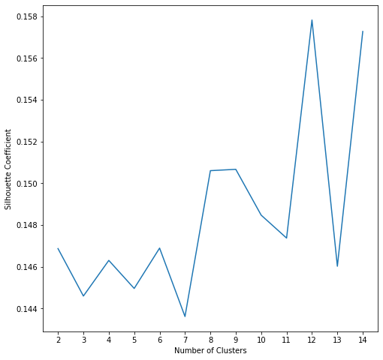
Silhouette Coefficient
Measure of Cohesion(Intra-Cluster Distance) and Separation(Inter-Cluster Distance)
Higher values of silhouette coefficient indicate higher intra-cluster similarity and higher inter-cluster similarity

Slide 24
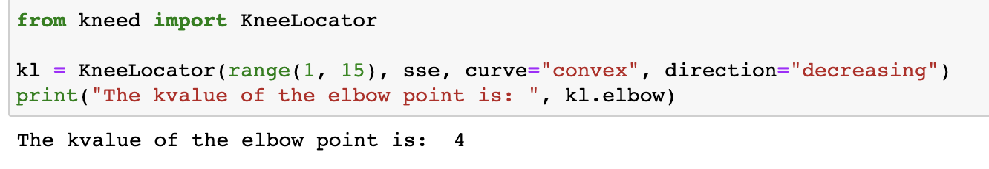

Slide 25
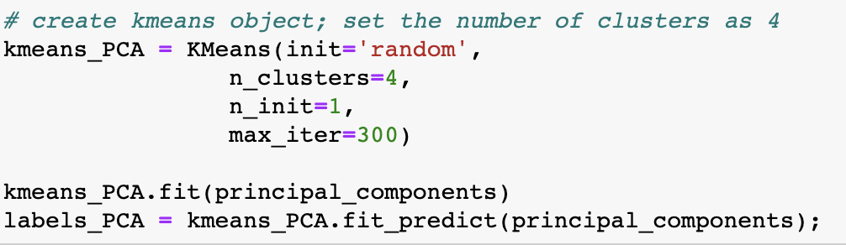

Slide 26
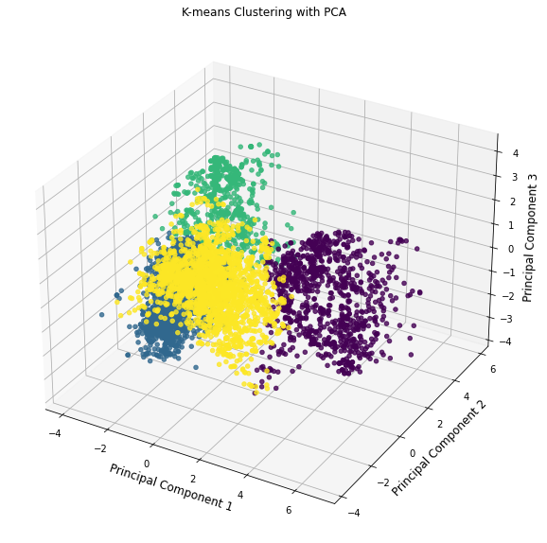

Slide 27
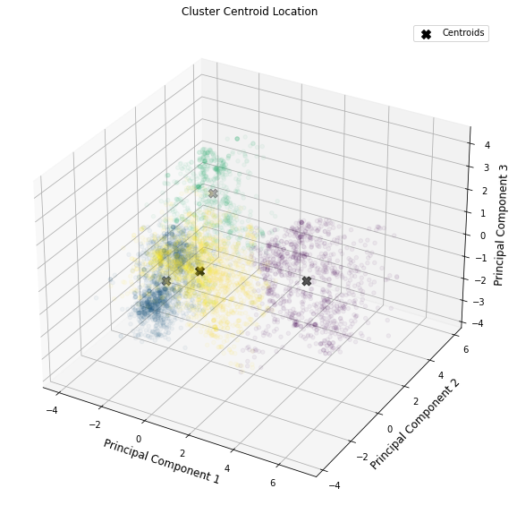

Slide 28
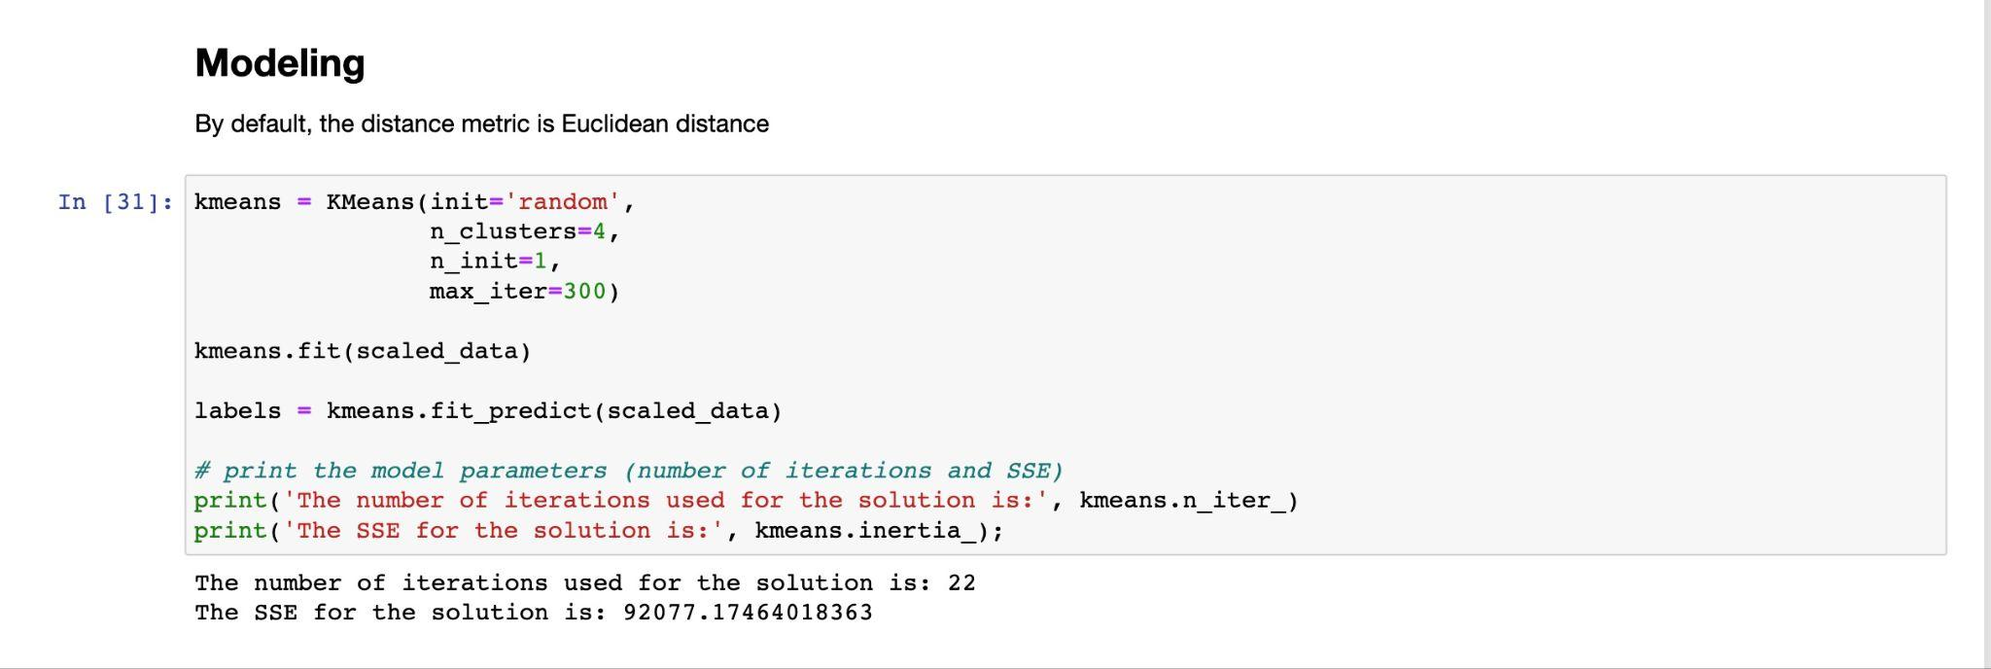

Slide 29
04
Empirical findings

Slide 30
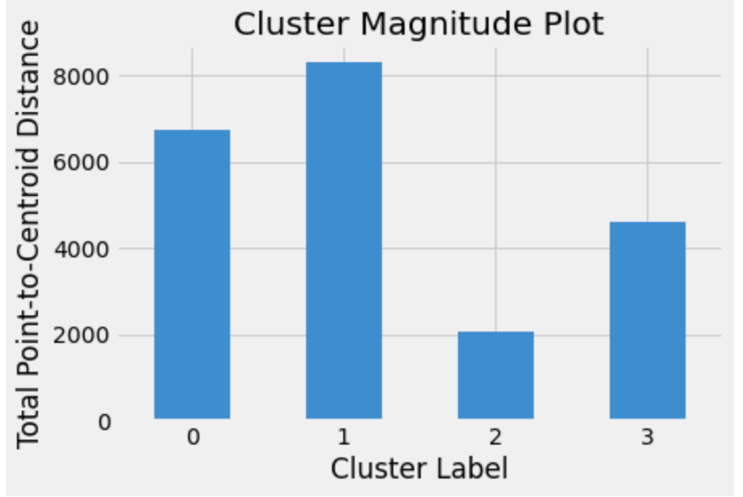
Each Cluster’s popularity

Slide 31
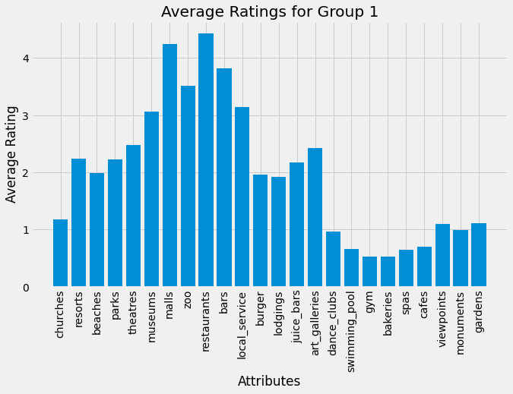
Group 1
Like restaurants most
5,608 Likes
Also have great preference to malls and bars
Can be identified as business travellers.

Slide 32

Advertisement Strategy
Promote high-end restaurant and bars that used for negotiate business on website like hotel-booking and flights-booking because those are two website they will use most.

Slide 33
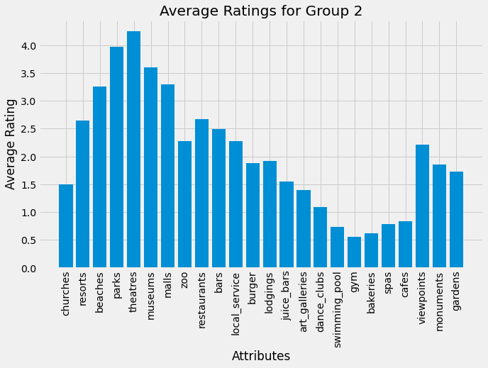
Group 2
Like theatres most
5,608 Likes
Also have great preference to parks and museums
Can be identified as leisure travellers

Slide 34

Advertisement Strategy
They would likely to do travel guides and tips. We can attract those group of people by promote advertisement like beaches, museums on google or Yelp.

Slide 35
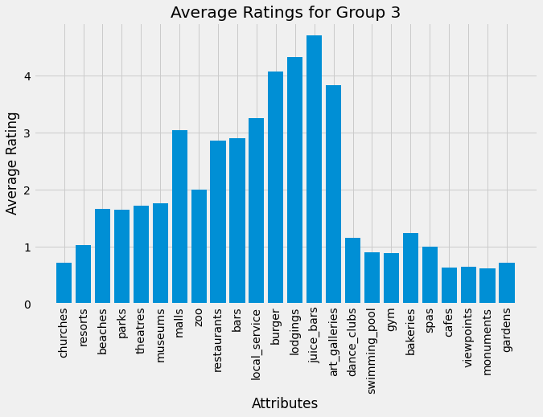
Group 3
Like Juice Bar most
5,608 Likes
Also have great preference to lodgings and art galleries
Can be identified as foodie travellers.

Slide 36

Advertisement Strategy
They would likely to do explore local foods and try traditional cuisines, but they do not like to explore the country by going to historical sites. We can promote personalized advertisements like night market, farmers market.

Slide 37
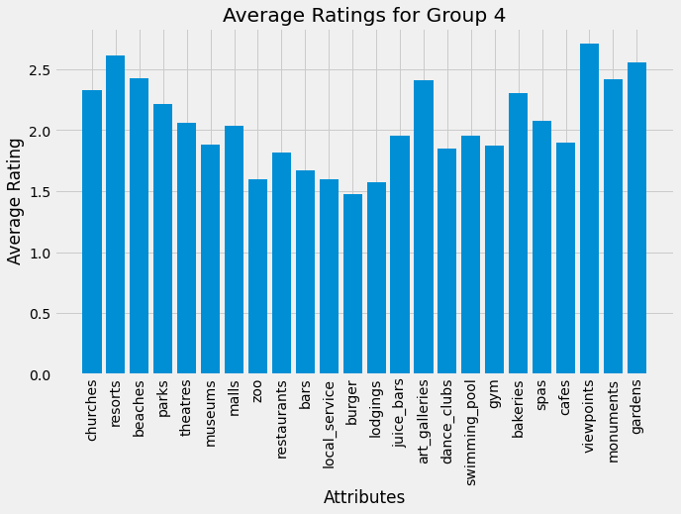
Group 4
Like view points most
5,608 Likes
Also have great preference to resorts and gardens
They are group of people who are likely to rate low.

Slide 38
Thanks!
Do you have any questions?

